Slide 1
Article name:
Heat stable Carbetocin versus Oxytocin to prevent hemorrhage vaginal birth
Authors: M.Widmer , G.Piaggio, T.M.H.Nguyen et al
Journal: The new England journal of medicine
Published on: June 2018

Slide 2
Background information
Post partum hemorrhage is the most common cause of maternal death.
Postpartum bleeding or postpartum hemorrhage (PPH) is often defined as the loss of more than 500 ml or 1,000 ml of blood within the first 24 hours following child birth.
PPH accounts for 661,000 deaths worldwide between 2003 and 2009.
More than 70% of hemorrhagic deaths occurs post partum , and most are due to uterine atony (poor contraction of the uterus after birth).
The most common cause is poor contraction of the uterus following childbirth.
Other causes: Not all of the placenta being delivered, a tear of the uterus, or poor blood clotting.

Slide 3
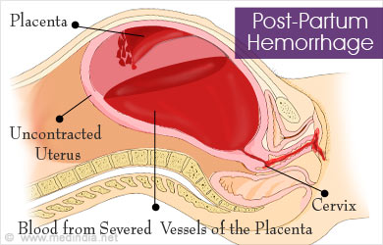
Background information

Slide 4
Management and treatment
High-quality evidence suggests that active management of the third stage of labor reduces the incidence and severity of PPH.
Active management is the combination of :
uterotonic administration (preferably oxytocin) immediately upon delivery of the baby,
(2) early cord clamping and cutting, and
(3) gentle cord traction with uterine countertraction when the uterus is well contracted (ie, Brandt-Andrews maneuver).
Notes:
THIRD STAGE: TIME BETWEEN BIRTH OF THE BABY AND COMPLATE EXPLUSION OF THE UTERUS.
applying counter pressure to help deliver the placenta

Slide 5
Oxytocin is the standard therapy for prevention of post partum hemorrhage .
But it has unsatisfactory real world efficacy as a result of sensitivity to heat and quality issues such as insufficient active ingredient and impurities.

Slide 6
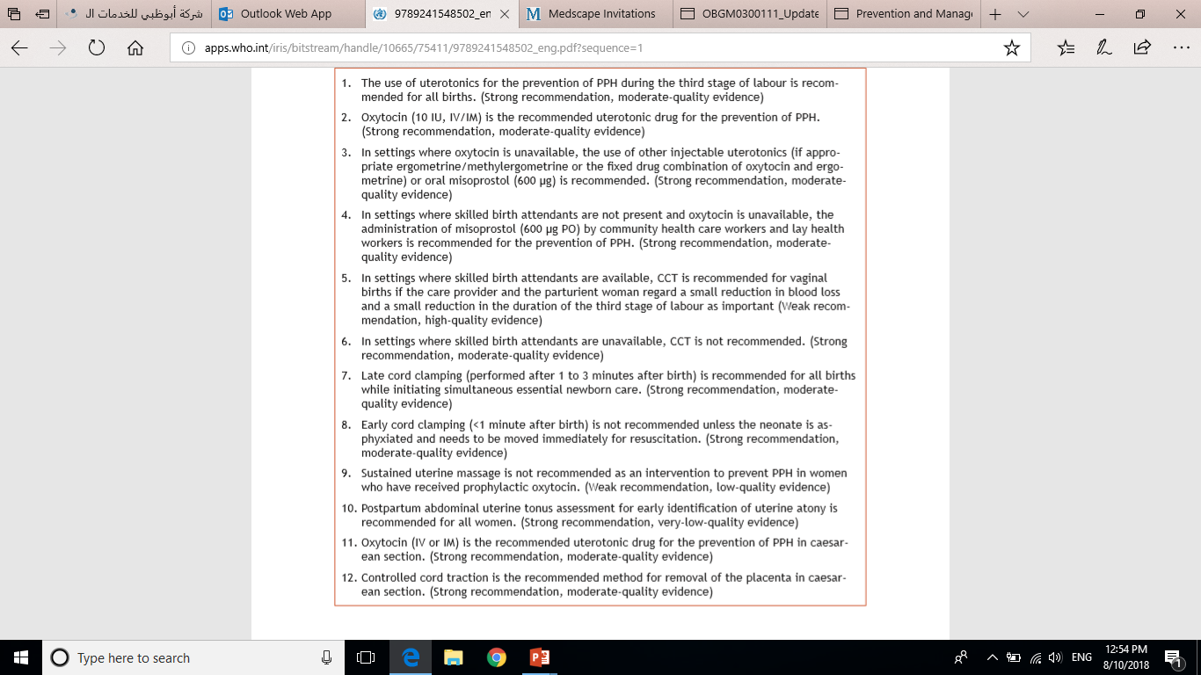
WHO guidelines in PPH (2012)

Slide 7

WHO guidelines in PPH (2012)

Slide 8
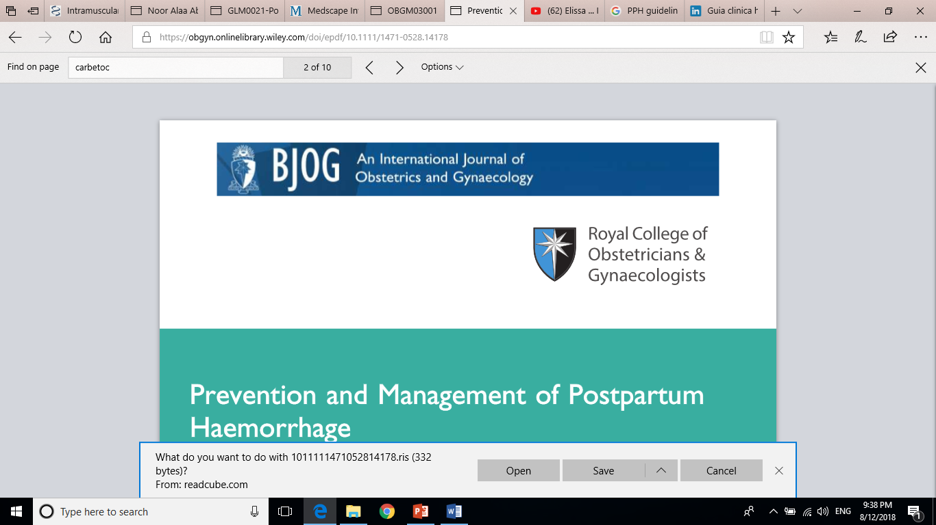
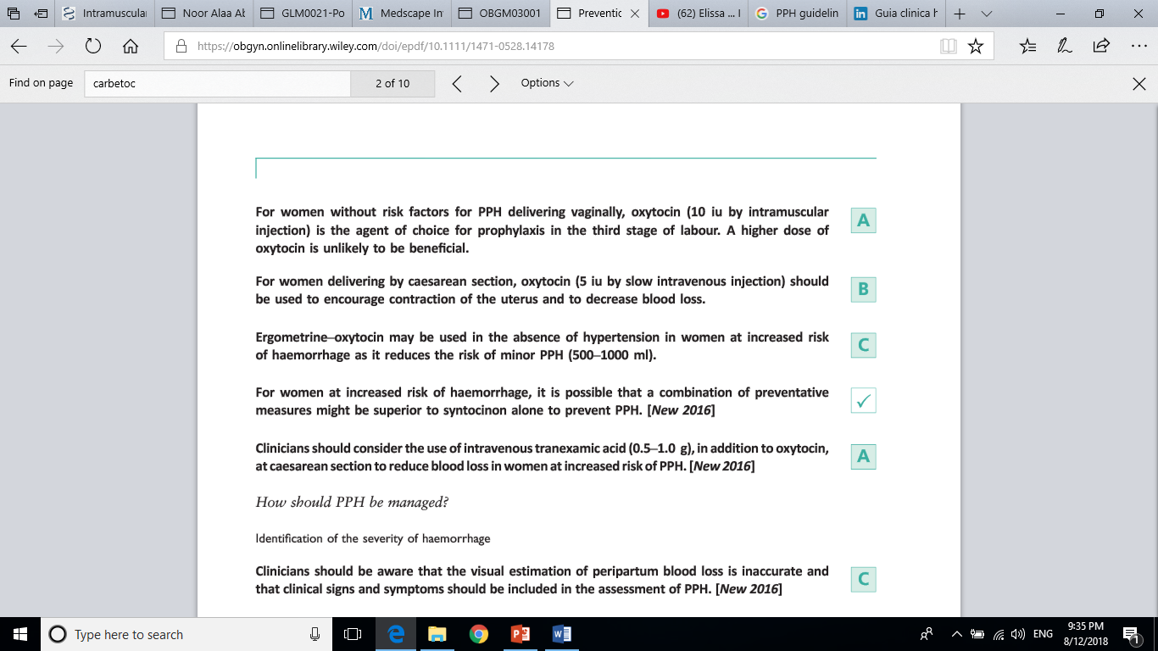

Slide 9
WHO didn’t include recommendation for carbetocin in its 2012 guidelines regarding PPH.
What’s unique about carbetocin ???
An oxytocin analogue
Doesn’t require cold chain transport and storage
Maintain stability over a period of 36 months at 30 degrees and 75% relative humidity.
It differs from the existing non heat stable formulation only in its excipient.

Slide 10
Article:
Heat stable Carbetocin versus Oxytocin to prevent hemorrhage vaginal birth

Slide 11
Objective:
Compare the novel formulation of intramuscular heat-stable carbetocin (at dose of 100 mcg) with oxytocin (at dose of 10 IU) in preventing PPH during third stage of labor in women giving birth vaginally.
Design:
International, randomized, double blind, active controlled, non inferiority trial.

Slide 12
Method
Trial was done among 23 hospitals in 10 countries between July 2015 – Jan 2018 .
Inclusion criteria
Women who expected to give birth vaginally, and who had a singleton pregnancy.
Cervical dilatation of 6 cm or less.
Exclusion criteria:
Women at advanced stage of labor (cervical dilatation > 6 cm).
Women who were too distressed to provide informed consent.
Women who had known allergies to carbetocin, oxytocin homologues, or excepients.
Women with serious CVD, hepatic or renal diseases, or epilepsy.
Notes:
Noninferiority trials are used to assess whether the effect of a new drug is not worse than an active comparator by more than a noninferiority margin. If the difference between the new drug and the active comparator does not exceed this prespecified margin, noninferiority can be concluded.

Slide 13
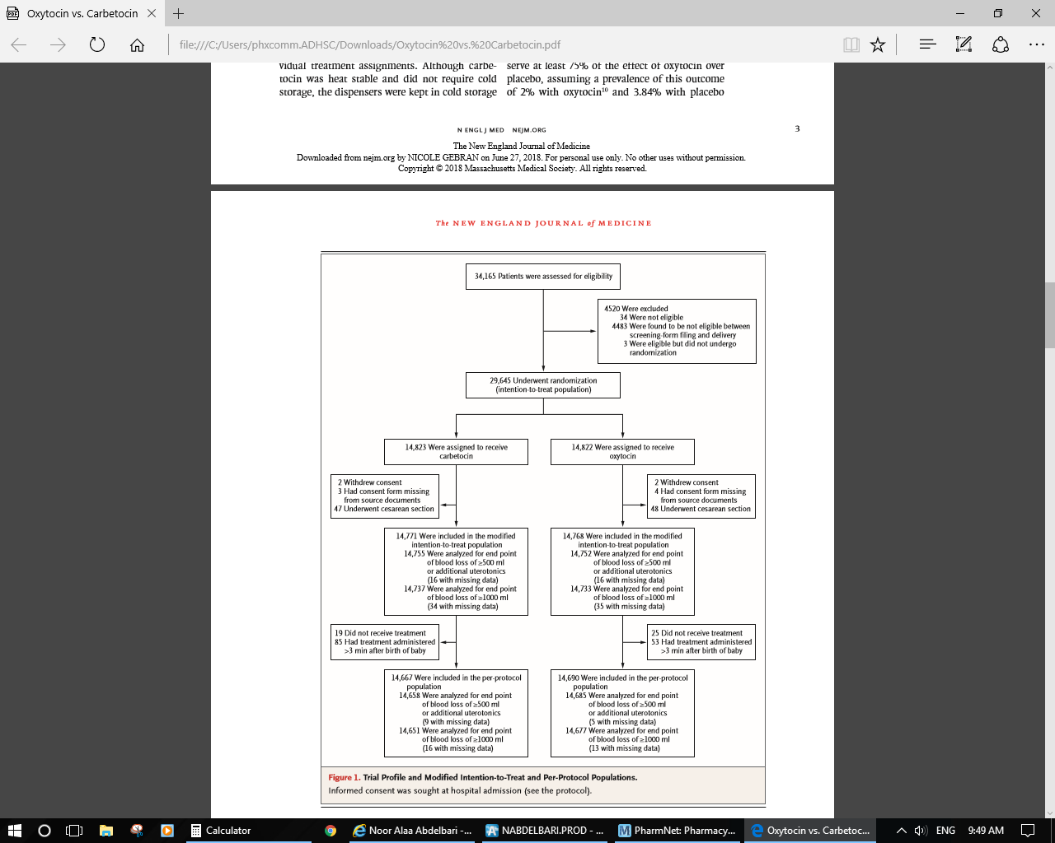
Notes:
Per protocol analysis excludes patients who deviated from the protocol. It can introduce a form of bias called attrition bias, in which the groups of patients being compared no longer have similar characteristics.
In intention to treat analysis, the results from all patients assigned to a group are taken into account, including those who deviated from the protocol.
The results of per protocol analysis usually provide a lower level of evidence but better reflect the effects of treatment when taken in an optimal manner. Per protocol analysis is particularly useful for interpreting non-inferiority trials and, under given conditions, for analysing the adverse effects of treatments. Be wary of "modified" intention to treat analyses that do not include all patients assigned to a group by randomisation: they are actually "extended" per protocol analyses.
Analyses were planned according to the modified
intention-to-treat and per-protocol populations.
The modified intention-to-treat population
included all the participants who underwent randomization
except those who withdrew consent,
those whose consent form was missing from
source documents, and those who underwent cesarean
section.
The per-protocol population included
all the participants who received the assigned
treatment within 3 minutes after delivery.
Intention-to-treat analysis is a comparison of the treatment groups that includes all patients as originally allocated after randomization. This is the recommended method in superiority trials to avoid any bias.
Per-protocol analysis is a comparison of treatment groups that includes only those patients who completed the treatment originally allocated. If done alone, this analysis leads to bias.
I
The intention-to-treat principle defines that every patient randomized to the clinical study should enter the primary analysis. Accordingly, patients who drop out prematurely, are non-compliant to the study treatment, or even take the wrong study treatment, are included in the primary analysis within the respective treatment group they have been assigned to at randomization (“as randomized”).n noninferiority trials, both intention to treat and per-protocol analysis are recommended; both approaches should support noninferiority.
Consequently, in an analysis according to the ITT principle, the original randomization and the number of patients in the treatment groups remain unchanged, the analysis population is as complete as possible, and a potential bias due to exclusion of patients is avoided. Thus, the patient set used for the primary analysis according to the ITT principle is called “full analysis set”.
There are only some specific reasons that might cause an exclusion of a patient from the full analysis set:
no treatment was applied at all
there are no data available after randomization
While an analysis according to the ITT principle aims to preserve the original randomization and to avoid potential bias due to exclusion of patients, the aim of a per-protocol (PP) analysis is to identify a treatment effect which would occur under optimal conditions; i.e. to answer the question: what is the effect if patients are fully compliant? Therefore, some patients (from the full analysis set) need to be excluded from the population used for the PP analysis (PP population).
We found that the mITT trials were significantly more likely to perform post-randomization exclusions
The intention-to-treat principle requires that all participants that are randomized must be included in the final analysis and analyzed according to the treatment group to which they were originally assigned, regardless of the treatment received, withdrawals, lost to follow-up or cross-overs.

Slide 14
Method
IM injection
Of heat stable carbetocin at dose of 100 mcg
n= 29,645
Oxytocin at dose of 10 IU
Randomized to either receive
Administered immediately after the birth of baby to manage the third stage of labor according to WHO guidelines
Both medications were supplied in 1 ml ampoules in consecutively numbered treatment packs, and were arranged in dispensers.
The ampoules, trial packs, and dispensers were identical in shape, size, and weight to ensure blindness.
Both medications were kept in cold storage (2-8 degree) to maintain double blinding and to give oxytocin max efficiency.

Slide 15
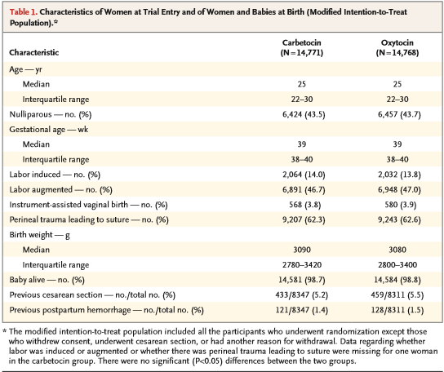
The characteristics at baseline and the birth
outcomes were similar in the two groups

Slide 16
Study outcomes
Primary outcome
Proportion of women with blood loss of at least 500 ml OR the use of additional uterotonic agents at 1 hour and up to 2 hours for women who continued to bleed after 1 hour.
The proportion of women with blood loss of at least 1000 ml at 1 hour and up to 2 hours for women who continued to bleed after 1 hour
Non inferiority margin for the relative risk is 1.16
Non inferiority margin for the relative risk is 1.23
preserve at least 82% of the effect of oxytocin over placebo
preserve at least 75% of the effect of oxytocin over placebo
Notes:
These numbers derived from previous systemic reviews.
If the difference between the new drug and the active comparator does not exceed this prespecified margin, noninferiority can be concluded
Noninferiority trials are used to assess whether the effect of a new drug is not worse than an active comparator by more than a noninferiority margin. If the difference between the new drug and the active comparator does not exceed this prespecified margin, noninferiority can be concluded.
The null hypothesis in a noninferiority study states that the primary end point for the experimental treatment is worse than that for the positive control treatment by a prespecified margin, and rejection of the null hypothesis at a prespecified level of statistical significance is used to support a claim that permits a conclusion of noninferiority

Slide 17
Study outcomes
Secondary outcome
Includes other measures related to blood loss such as:
Use of additional uterotonic agents.
Other interventions to stop bleeding.
Expected adverse events including chest pain, and vomiting.

Slide 18
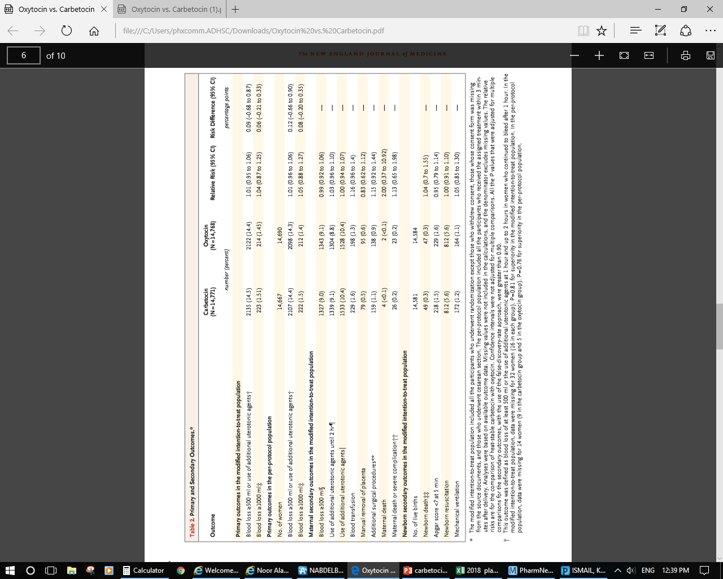
Notes:
Per protocol analysis excludes patients who deviated from the protocol

Slide 19
Statistical analysis
Primary outcomes
Non-inferiority analysis
Analysis were planned according to the modified intention to treat population, and pre-protocol population.
To conclude that heat-stable carbetocin was non-inferior to oxytocin, it was required that non-inferiority be shown in both the modified intention-to treat and per-protocol analyses.
Relative risk was calculated by Mantel-Haenszel method.
Confidence interval obtained by Wald method.
P-value from Mantel-Haenszel general association statistic.

Slide 20
Results (based on modified intention to treat population)
Primary outcome
Proportion of women with blood loss of at least 500 ml OR:
The use of additional uterotonic agents at 1 hour and up to 2 hours for women who continued to bleed after 1 hour.
Group | Primary outcome* | Relative risk | 95% C.I | P-VALUE
Oxytocin | 14.4% | 1.01 | 0.95 – 1.06 | < .001 For non- inferiority
Carbetocin | 14.5%
The result consistent with non-inferiority at the prespecified margin of 1.16.
Superiority was not shown ( P-value 0.81)

Slide 21
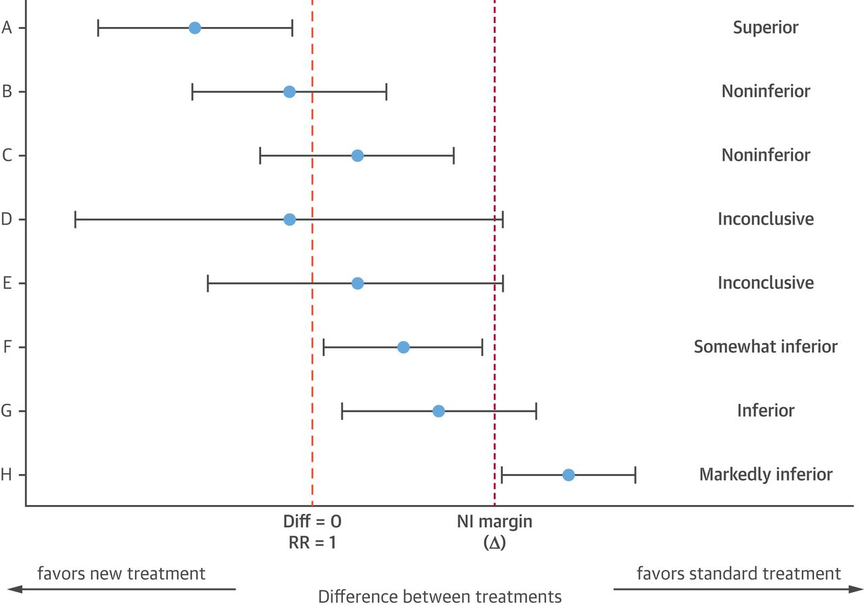
non inferiority margin: 1.16
0.95
1.06
95% CI

Slide 22
Results
Primary outcome
Blood loss of at least 1000 ml .
Group | Secondary outcome* | Relative risk | C.I | P-VALUE
Oxytocin | 1.45% | 1.04 | 0.87- 1.25 | 0.03 for non inferiority
Carbetocin | 1.51%
Non inferiority was not shown due to low events rates which reduced the power of the study.
The upper limit of the 95% C.I was above the pre-specified non-inferiority margin of 1.23 (so non-inferiority was not shown).
Notes:
Although sample size is large, but still it was under powered for the outcome of blood loss of at least 1000 ml .

Slide 23
non inferiority margin: 1.23
0.87
1.25
95% CI

Slide 24
Results
Secondary outcomes
Use of additional uterotonic agents.
Other interventions to stop bleeding.
Expected adverse events including chest pain, and vomiting.
There were no difference at the 5% level of significance between groups in the rates of the secondary outcomes
No significant difference with regard to secondary outcomes or adverse effects
Notes:
Although sample size is large, but still it was under powered for the outcome of blood loss of at least 1000 ml .

Slide 25
Discussion / conclusion
This trial showed that IM administration of 100 mcg of heat stable carbetocin was non-inferior to the administration of 10 IU of oxytocin for the prevention of post partum hemorrhage after vaginal birth.
(when the outcome was defined as blood loss of at least 500 ml or the use of additional uterotonic agents).

Slide 26
Critical appraisal

Slide 27
Heat stable Carbetocin versus Oxytocin to prevent hemorrhage after vaginal birth
Journal: The new England journal of medicine
Impact factor: 79.2
Authors:
M.Widmer
G.Piaggio
T.M.H.Nguyen

Slide 28
Critique
Background and Rationale: Satisfactory
  The background is presented appropriately and it is justified by the author as he mentioned that oxytocin has unsatisfactory real world efficacy as a result of heat sensitivity and quality issues such as insufficient active ingredient and impurities.
  And since carbetocin doesn’t require cold chain transport and storage, it will be more practical to be used in many countries.
  Previous trials
  The previous trials which include carbetocin involved women undergoing c-section, were small, were of varied quality, and used IV route.
A Cochrane review has addressed the use of a longer-acting oxytocin derivative, carbetocin, in the prevention of PPH. Carbetocin is licensed in the UK speciﬁcally for the indication of prevention of PPH in the context of caesarean delivery. Use of carbetocin resulted in a statistically signiﬁcant reduction in the need for further uterotonics compared with oxytoci n for those undergoing a caesarean, but not for vaginal delivery. However, there were no statistically signiﬁcant differences between carbetocin and oxytocin in terms of risk of PPH.

Slide 29
Critique (Cont’d)
Previous trials
Guidelines from the Society of Obstetricians and Gynaecologists of Canada recommend that carbetocin (100 micrograms given as an intravenous bolus over 1 minute ) should be used for the prevention of PPH in elective caesarean deliveries.
Randomized trials have compared different uterotonics (oxytocin, ergometrine–oxytocin, misoprostol, carbetocin and 15-methyl prostaglandin ) for prophylaxis in women delivering by caesarean section. Appraisal of the evidence from these trials , together with consideration of standard practice in the UK, led the development group for the NICE caesarean section guideline to recommend oxytocin 5 IU by slow intravenous injection for prophylaxis in the context of caesarean delivery.

Slide 30
Critique (Cont’d)
Objectives and/or Hypothesis: satisfactory
The objective of the study was stated clearly about studying non-inferiority of heat stable formulation of carbetocin in comparison with oxytocin in preventing PPH.
Control of Treatment-Related Bias: Satisfactory
The study was double blinded.
Both medications were supplied in 1 ml ampoules in consecutively numbered treatment packs, and were arranged in dispensers.
The ampoules, trial packs, and dispensers were identical in shape, size, and weight to ensure blindness.
Both medications were kept in cold storage (2-8 degree) to maintain double blinding and to give oxytocin max efficiency.
Random assignment done through computer generated random numbers.
The drugs, doses , regimen, and time of administration was mentioned clearly.

Slide 31
Critique (Cont’d)
Control of Extraneous Variables: Satisfactory
The investigators were unaware of the group assignment.
The interim analysis were blinded to everyone except the members of the data and safety monitoring committee.
There is no investigator bias since the data was collected and analyzed by different programs and committees.
Base line characteristics were analyzed between the 2 groups, and it showed non significant differences.
The risk differences was adjusted for country by using Mantel-Haenszwel method.
Non inferiority was shown in both pre-protocol population and modified intention to treat population to ensure that heat stable carbetocin is non inferior to oxytocin.
Missing values were not computed.
Notes:
Modefied intention to treat population included all the participants who underwent randomization, except those who withdrew consent, underwent c-section, or consent was missing.
Pre protocol population, all participants who received the assigned treatment withn 3 min after delivery.
Per protocol analysis excludes patients who deviated from the protocol. It can introduce a form of bias called attrition bias, in which the groups of patients being compared no longer have similar characteristics.
In intention to treat analysis, the results from all patients assigned to a group are taken into account, including those who deviated from the protocol.

Slide 32
Critique (Cont’d)
Description: Marginal/ satisfactory
The pharmacological action of the drugs were not explained clearly.
The side effects of the medications were mentioned in a table and the most frequently adverse effects of drugs were presented clearly with the % of patients who experienced those adverse effects.
The duration of the study was clear (participation ended by discharge from facility, transfer of the women to higher care unit, or death).
The rationale for comparing the two regimens is clear from clinical and economical perspective and this is done by proving non inferiority of heat stable carbetocin in comparison with oxytocin.

Slide 33
Critique (Cont’d)
Dosage: Marginal - Satisfactory
The patients were receiving adequate doses in both groups, and the exact timing of administering the drug is clear (3 min after delivery).
The routes of administration for the drugs were appropriate.
The study only compared the IM route of the medications (but not the IV route)
Previous trials (regarding route)
A recent Cochrane systematic review looked at the effect of prophylactic oxytocin for the management of the third stage of labor and found that it is effective in preventing blood loss ≥ 500 mL at any dose, in the range of 3–10 IU, compared with placebo. The need for additional uterotonics is reduced when a 10 IU dose is used and when given as an IV bolus. The guidelines of the Royal College of Obstetricians and Gynaecologists (RCOG) and the Royal College of Physicians of Ireland (RCPI) recommend an IM bolus dose of 10 IU of oxytocin following delivery of the infant . The WHO guidelines recommend oxytocin 10 IU intramuscularly or by slow IV injection.
Notes:
Oxytocin can be given intravenously or intramuscularly [11]. The intramuscular (IM) route has the advantage of ease of administration and requires relatively less skill to administer. Following IM injection, the effect on the uterus appears within 3–7 min and persists for 30–60 min. With the intravenous (IV) route the uterine response is almost instantaneous, within 1 min or less, compared to IM administration which results in a slower onset of action but produces a longer lasting effect

Slide 34
Duration: satisfactory
According to the aim of the study, the duration is sufficient for assessing the effect of carbetocin and oxytocin in preventing PPH.
Sample Representative of Clinical Population: satisfactory
The enrolled patients are only those patients who:
Women who expected to give birth vaginally, and who had a singleton pregnancy.
Cervical dilatation of 6 cm or less.
Received treatment within 3 min after delivery.
The sample size was sufficient (99% power) to support the first primary outcome , but it wasn’t sufficient to support the second primary outcome due to low events rates which reduced the power of the study.
The demographic data and the characteristics of women at trial entry and of women and babies at birth are mentioned clearly.
The included population are representative to the real clinical population (pregnant women with vaginal delivery).
This study underestimated the benefit that would be expected with the use of carbetocin in low income and middle income countries.

Slide 35
Critique (Cont’d)
Subjects compliance : N/A
The medication was administered by physician after vaginal delivery .
Scope of Assessment: satisfactory.
The trial protocol was approved by the ethics committee and regulatory agencies in each country, by the research proposal review panel of the special program of research in human reproduction that is based at the WHO, and the WHO ethics review committee.
External data and safety monitoring committee had reviewed the safety and efficacy of the study, and they recommended continuation of the trial.
Trial initiation, monitoring , and closure, and safety monitoring at the trial sites were provided by IQVIA .
External committees had provided assistance in terms of online trial preparation, data entry system, electronic case recored form, and data monitoring and cleaning.
The trial protocol, statistical analysis plan, and manuscript were written by HRP staff, independent of steering committee members who were not WHO staff or site investigators.

Slide 36
Continue: Scope of Assessment: satisfactory.
The trial was supported by MSD , and it has no commercial interest in the investigational drug.
Heat stable carbetocin was provided by Ferring pharmaceutical, and oxytocin by Novartis free of charge.
Novartis had no other role in the trial.
MSD and ferring pharmaceutical provided input into the protocol and could provide comments on the manuscripts, although there was no obligation on the part of the team to incorporate them.
No company had the right to final approval of the manuscript or to control the decision to submit the manuscript for publication.

Slide 37
Critique (Cont’d)
Assessment Measures: satisfactory
Patient response to treatment was assessed by the volume of blood after delivery
(once the umbilical cord was clamped and cut, a plastic drape for blood collection was placed under the woman’s buttocks. Blood was collected for 1 hour and for 2 hours if the bleeding continued beyond 1 hour. Then the blood was weighed by digital scale, with the weight recorded in grams and then converted into volume (ml).
Assessment schedule: satisfactory
The medication were given 3 min after vaginal birth following the WHO guidelines, and bleeding was monitored for 1 and 2 hours. This schedule is appropriate for the aim of the study.
Conduct of assessment: satisfactory
Consistent assessment techniques were used for both groups throughout the trial.
Data presentation: satisfactory
The data were presented clearly and in a meaningful way.
Appropriate level of data details.
P-values and confidence intervals were mentioned in the study.
Missing data on outcome were not computed and all the analysis was done on an intention-to-treat basis with data for patients who completed the 48 week assessment (and on pre-protocol population) / eliminate attrition bias

Slide 38
Critique (Cont’d)
Statistical analysis: satisfactory
Appropriate statistical tests were done to analyze the data.
The primary analysis was performed in the (intention to treat population), which reflects the real clinical population.
To account for missing data, multiple imputation logistic regression modeling was used.

Slide 39
Critique (Cont’d)
Data synthesis : satisfactory
Systemic approach which was used to answer the research question is clear.
All results were demonstrated on tables and figures and they were easy to understand.
Focus: satisfactory
The conclusion of the study and the interpretation was very clear and they were related to the research question.
Logic: satisfactory
Conclusion is logical since it is supported and consistent with the presented statistical data collected throughout the study.
Application: satisfactory
the study has sufficient power (80%), this means the sample size is adequate to represent the population, however, the study included only patients who are not distressed (early stage of labor) , this may restrict the generalization of the results.
The author didn’t mention the limitation of the study clearly.

Slide 40
Critique (Cont’d)
Place in therapy:
According to the results of the study, heat stable carbetocin can be used to prevent PPH on the world where a lack of heat stability is a barrier to the effective prevention of PPH.
Further studies are needed to study the effect among patients with different levels of risk and with fewer limitations.

Slide 41
Thank you

